Slide 1
Database
A database is a structured collection of data.
Its primary purpose is to organize data for efficient retrieval and manipulation.
Databases are used to store information for various applications, such as websites, business applications, and more.
They play a crucial role in managing and maintaining large volumes of structured data.

Slide 2
Data Models
Data models are visual representations of an enterprise’s data elements and the connections between them. Models assist to define and arrange data in the context of key business processes, hence facilitating the creation of successful information systems. They let business and technical personnel to collaborate on how data will be kept, accessed, shared, updated, and utilized within an organization.
Reference

Slide 3
Benefits of Data Modelling
Visualizes complex data structures, providing a clear roadmap for understanding relationships.
Acts as a universal language, fostering effective communication between business and technical stakeholders.
Creates organized databases by defining entities, properties, and relationships.
Enhances data quality and integrity by reducing anomalies and redundancy through normalization.
Minimizes errors in database and application development.
Ensures consistency in documentation and system designs across the organization.
Improves database and application performance.
Facilitates quick correlation of data across the company.
Strengthens communication between business intelligence and development teams.

Slide 4
Data Modelling Process
Identifying data sources.
Defining Entities and Attributes.
Mapping Relationships.
Choosing a model type.
Implementing and maintaning.

Slide 5
Entities, Relationships, and Attributes
Entity
An entity is anything that can have data stored about it. It can be a physical object (e.g. car, person), a concept (e.g. address) or an event (e.g. student enrolment in a course). They represent nouns. They are usually represented as rectangles on an ERD (entity relationship diagram) with the entity name inside the rectangle.
An entity can also be a strong entity or a weak entity. What’s the difference?
A strong entity has an identifier (a primary key) and does not depend on any other entities for it to exist. For example, a student may be a strong entity, as it can have a primary key and does not depend on any other entities for it to exist.
A weak entity is one that depends on a strong entity for existence. This means it has a foreign key to another entity. For example, an enrolment of a student may be a weak entity, as an enrolment cannot exist without a student.
Relationship
A relationship in an ERD defines how two entities are related to each other. They are represented as lines between two entities, and often have a label to further describe the relationship (such as “enrolls”, “registers”, “completes”). There are several types of relationships that are represented on an ERD:
One to one: One record of an entity is directly related to another record of an entity
One to many: One record of an entity is related to one or more records of another entity.
Many to one: Many records of one entity can be related to one record of another entity.
Many to many: Many records of one entity can be related to many records of another entity.

Slide 6
Attributes
An attribute is a property of an entity or something that can be used to describe an entity. They are often represented as ovals, or as entries inside an entity.
There are several different types of attributes represented on an ERD:
Simple: an attribute that cannot be split into other attributes, such as a first name.
Composite: an attribute that can be split into other attributes, such as name being split into first, middle, and last name.
Derived: an attribute that is calculated or determined from another attribute, such as the age of record being calculated from the created date.
An attribute can also be single-value or multi-value:
Single-value: an attribute that is only captured once for an entity, such as gender.
Multi-Value: an attribute that can be captured more than once for an entity, such as multiple phone numbers.

Slide 7
Database Normalization
Database normalization is a database design principle for organizing data in an organized and consistent way that helps to avoid redundancy and maintain the integrity of the database. It also helps to eliminate undesirable characteristics associated with insertion, deletion, and updating.
The main purpose of database normalization is to avoid complexities, eliminate duplicates, and organize data in a consistent way. In normalization, the data is divided into several tables linked together with relationships. Database administrators are able to achieve these relationships by using primary keys, foreign keys, and composite keys.
Reference

Slide 8
Data Modelling Stages
Conceptual Data Model: Conceptual Data Model is a representation of data that examines and describes the abstract and high-level business concepts and structures. They are commonly employed when working through high-level concepts and preliminary needs at the start of a new project. They are typically developed as alternatives or preludes to the logical data models. The main purpose of this data model is to organize, define business problems , rules, and concepts.
Logical Data Model: offers a thorough representation of the data at a logical level which expands on the conceptual model. It outlines the Entities, Attributes, and Relationships that make up the data structure. Although logical data models are not dependent on any particular database management system (DBMS), they are more similar to how data would be implemented in a database. The physical design of databases is based on this idea.
Physical Data Model: this outlines every part and service needed to construct a database. It is made with queries and the database language and contains tables, columns, and constraints—such as primary key, foreign key, NOT NULL, etc. This model explains how the data model is specifically implemented.

Slide 9
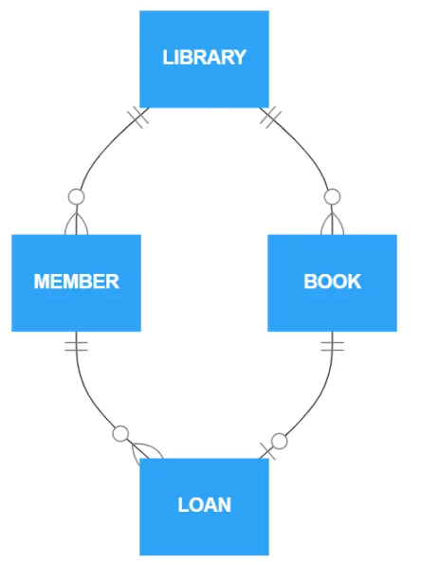
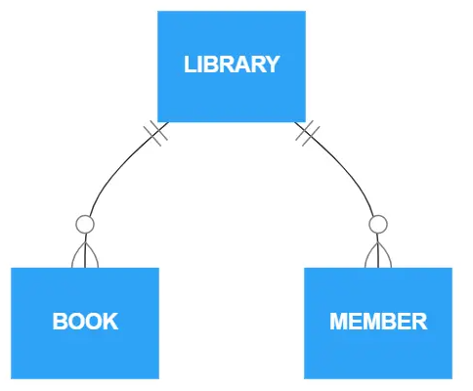
Conceptual Data Model

Slide 10
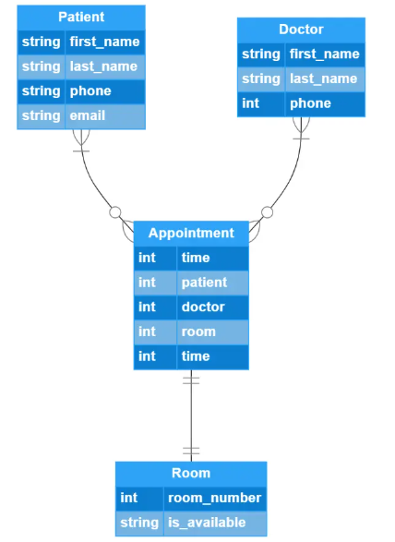
Logical Data Model

Slide 11
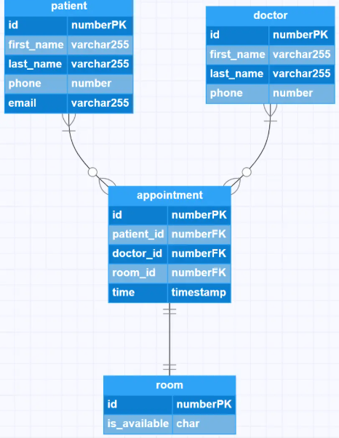
Physical Data Model

Slide 12
Data Modelling Types
Hierarchical Model: The structure of the hierarchical model resembles a tree. The remaining child nodes are arranged in a certain sequence, and there is only one root node, or one parent node. Approach connections in the actual world may be modelled using this approach. For example, in a college there are many courses, many professors and students. College became a parent and professors and students became its children.
Relational Model: this represents the links between tables by representing data as rows and columns in tables. It’s frequently utilized in database design and is strongly related to relational database management systems (RDBMS).
Object-Oriented Data Model: In this model, data is represented as objects similar to those used in object-oriented programming. Creating objects with stored values is the object-oriented method. In addition to allowing data abstraction, inheritance, and encapsulation, the object-oriented architecture facilitates communication.
Network Model: One of its features is a schema, which is a graph representation of the data. An item is stored within a node, and the relationship between them is represented as an edge. This allows them to generalize the maintenance of many parent and child records.
ER-Model: it’s a high-level relational model that specifies the data pieces and relationships between the entities in a system. This conceptual design gives us an easier-to-understand perspective on the facts.

Slide 13
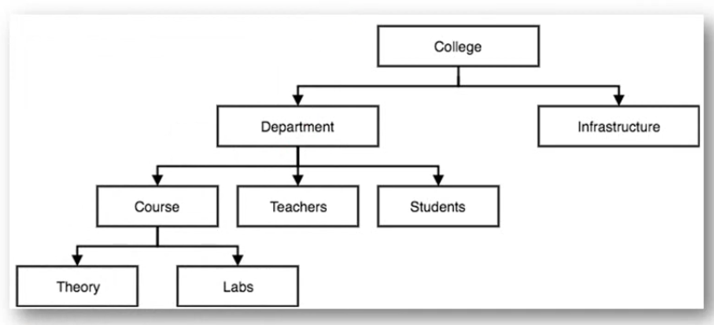
Hierarchical Model

Slide 14
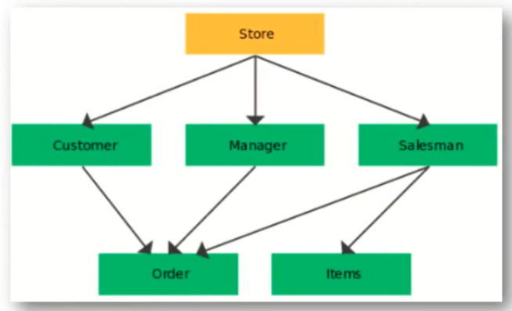
Network Model

Slide 15
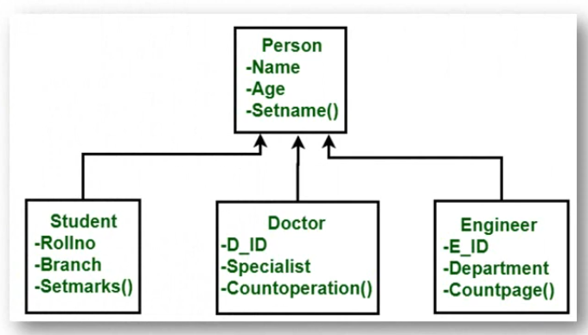
Object-Oriented Data Model

Slide 16
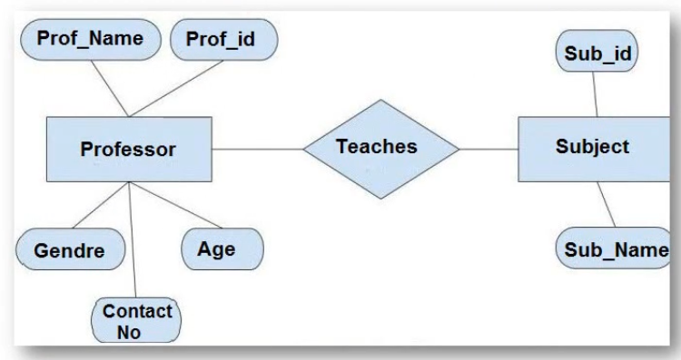
ER-Model

Slide 17
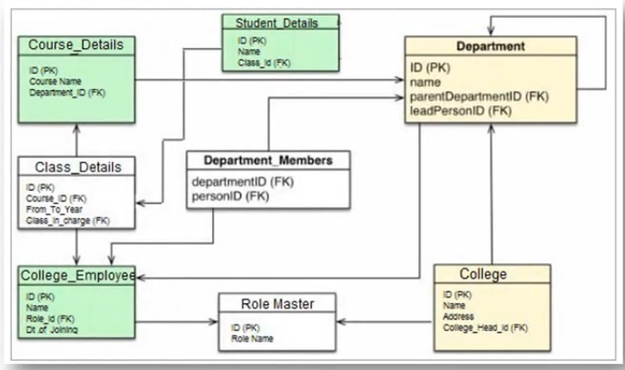
Relational Model

Slide 18
Types of Databases
There are different types of databases such as:
Relational Databases
NoSQL Databases
Object Oriented Databases
Hierarchical Databases
Network Databases
Centralized Databases
Distributed Databases
Analytical Databases
Personal Databases, and so on.
For this program, however, we will be focusing on Relational and a little bit of NoSQL Databases.

Slide 19
Relational Databases
The most widely used type of database that stores data in tables, which consist of rows and columns. Each table has a unique key that identifies its rows. SQL (Structured Query Language) is used to manage and query data in relational databases. Examples include MySQL, PostgreSQL, and Oracle. Some of its key features are:
Organizes data into structured tables with rows and columns.
Uses a predefined schema to define data structure.
Ensures data integrity and consistency
SQL (Structured Query Language) is the standard language for managing and querying relational databases.
Allows for vertical scaling which makes it hard to scale.
It’s vertical scaling also makes it expensive to maintain.

Slide 20
Introduction to SQL
SQL(Structured query language) is a specialized language used for managing and querying databases.
It provides a standardized way to interact with relational databases.
SQL became a standard of the American National Standards Institute (ANSI) in 1986, and of the International Organization for Standardization (ISO) in 1987
SQL is essential in performing the CRUD(create, retrieve, update, and delete) operations:
executing queries against a database
retrieving data from a database
inserting records into a database
updating records in a database
deleting records from a database
creating new databases
creating new tables in a database
creating stored procedures in a database
creating views in a database
setting permissions on tables, procedures, and views

Slide 21
Importance of SQL
Critical for Data Management:
SQL is the foundation of data management in most organizations.
It allows for efficient data retrieval, modification, and analysis.
Used in a Wide Range of Applications:
Business intelligence relies on SQL for querying and reporting.
Data analysts and data scientists use SQL to extract insights from data.
SQL is used in web development to interact with databases.

Slide 22
Setting Up the Development Environment
Choose a Database Management System (DBMS):
Select a DBMS based on your project's requirements.
Consider factors like scalability, data structure, and community support.
Popular DBMS Options:
MySQL: A widely used open-source relational database.
PostgreSQL: Known for its advanced features and extensibility.
SQLite: A lightweight, serverless, and self-contained relational database.
MongoDB: majorly used for NoSQL related projects.
Install the DBMS on Your Computer:
Follow installation instructions for your chosen DBMS.
Ensure that your environment is properly configured for database development

Slide 23
SQL Syntax
The word syntax simply means the arrangement of words and phrases to create a well-formed sentence in a language. SQL syntax is therefore the arrangement of keywords that enables you perform specific actions on a database.
Proper syntax ensures that the database management system (DBMS) can understand and execute the commands accurately. SQL commands are divided into various statements, and each statement serves a specific purpose and must adhere to its own syntax rules.
Common SQL statements:
SELECT: Used to retrieve data from one or more tables.
INSERT: Adds new records into a table.
UPDATE: Modifies existing records in a table.
DELETE: Removes records from a table.
CREATE: Creates new databases and tables with specified columns and data types
Reference

Slide 24
Basic Syntax Rules
SQL commands are case-insensitive (e.g., SELECT is the same as select).
SQL statements end with a semicolon (;).
SQL keywords are typically written in uppercase for clarity, but it's not mandatory.
SQL statements should be written on one line or multiple lines for readability.
Use single or double quotes for enclosing string values ('value' or "value").

Slide 25
SQL Data Types
Each column in a database table is required to have a name and a data type. An SQL developer must decide what type of data that will be stored inside each column when creating a table. The data type is a guideline for SQL to understand what type of data is expected inside of each column, and it also identifies how SQL will interact with the stored data. The different categories a table’s column can store are:
String Data Types.
Numeric Data Types.
Data and Time Data Types.
Reference

Slide 26
Types of SQL Commands
SQL commands are essential tools for interacting with a relational database. They are categorized into five types, each serving a specific purpose:
DDL (Data Definition Language) : Used to create, alter, and delete database objects like tables, indexes, etc. (CREATE, DROP, ALTER, RENAME, TRUNCATE)
DQL (Data Query Language) : Used to retrieve data from databases. (SELECT)
DML (Data Manipulation Language): Used to modify the database. (INSERT, UPDATE, DELETE).
DCL (Data Control Language): Used to grant & revoke permissions. (GRANT, REVOKE).
TCL (Transaction Control Language): Used to manage transactions. (COMMIT, ROLLBACK, START TRANSACTIONS, SAVEPOINT).
Additionally, it's worth noting that the Data Control Language (DCL) aspect won't be covered in detail for the backend cohort. DCL primarily deals with security and access control and is often handled by database administrators or specialized roles

Slide 27
Data Definition Language (DDL)
DDL is responsible for defining and managing the structure of databases and their objects. Key DDL commands include:
CREATE TABLE: This command is used to create new tables in a database. It specifies the table's structure, including column names, data types, and constraints.
ALTER TABLE: Alterations to existing table structures are made using this command. Common changes involve adding or modifying columns, changing data types, or adding constraints.
DROP TABLE: This command allows for the deletion of entire tables, along with all their associated data.
CREATE CONSTRAINT: Constraints are rules applied to maintain data integrity.
DROP CONSTRAINT: When constraints are no longer needed, the DROP CONSTRAINT command removes them from the database.
TRUNCATE TABLE: This command quickly removes all rows from a table while preserving the table's structure.
DDL is crucial for establishing the foundation of a database, defining relationships between tables, and ensuring data integrity. Understanding these DDL commands is fundamental for database administrators and developers working with SQL databases

Slide 28
Data Query Language(DQL)
Data Query Language (DQL) primarily focuses on retrieving data from databases. The foundational command in DQL is the SELECT statement, allowing you to extract specific columns from a table. Here are key components of DQL:
SELECT: The SELECT statement is used to retrieve data from a database. It follows the syntax: SELECT column1, column2, ... FROM table name; The * wildcard can be used to select all fields in a table.
WHERE: The WHERE clause is used to filter records based on specific conditions, employing operators like '=' , '>' , '<' , '>=' , '<=' , '<>' , and '!=' . You can also use logical operators like AND, OR, and NOT to combine conditions.
DISTINCT: The DISTINCT keyword removes duplicate rows from query results, ensuring unique values are returned.
LIKE: The LIKE operator is employed within the WHERE clause to search for specific patterns within a column, with the percent sign '%' representing multiple characters and the underscore sign '_' representing a single character.

Slide 29
Key Components of DQL
IN: The IN clause allows you to filter results based on a list of values within the WHERE clause.
BETWEEN: The BETWEEN clause filters results within a specified range in the WHERE clause.
IS NULL: The IS NULL clause checks for NULL values in the WHERE clause.
AS: The AS keyword is used to rename columns or expressions in query results.
ORDER BY: The ORDER BY clause enables sorting the result set based on one or more columns. It can sort in ascending or descending order and can also handle sorting by multiple columns and calculated expressions.

Slide 30
Data Manipulation Language
Data Manipulation Language (DML) in SQL covers commands designed to manipulate data within a database. DML commands are vital for ensuring the accuracy and currency of your data by enabling you to insert, update, and delete records:
INSERT: The INSERT statement adds new records to a table. Syntax:
INSERT INTO table name (column1, column2, ...) VALUES (value1, value2, ...); Example: INSERT INTO employees (first name, last name, salary) VALUES ('John' , 'Doe' , 50000);
UPDATE: The UPDATE statement modifies existing records in a table. Syntax:
UPDATE table name SET column1 = value1, column2 = value2, ... WHERE condition; Example: UPDATE employees SET salary = 55000 WHERE first name = 'John’;
DELETE: The DELETE statement removes records from a table. Syntax:
DELETE FROM table name WHERE condition; Example: DELETE FROM employees WHERE last name = 'Doe'; DML commands play a crucial role in managing the contents of a database, making them a fundamental part of SQL operations.

Slide 31
Data Control Language (DCL)
Data Control Language (DCL) commands in SQL play a pivotal role in maintaining the security and integrity of a database by controlling access rights and permissions. The primary DCL commands you'll encounter are GRANT, which provides privileges, and REVOKE, which removes privileges. These commands are essential for managing who can access and modify data within a database. It is typically managed by specialized roles or database administrators

Slide 32
Transaction Control language
Transaction Control Language (TCL) commands are essential for managing transactions within a database. These commands ensure data integrity and consistency throughout the database operations. Key TCL commands include:
COMMIT: This command makes changes within a transaction permanent, safeguarding data integrity.
ROLLBACK: When executed, it undoes changes made during a transaction, returning the database to its prior state.
SAVEPOINT: This command allows for more granular control over transaction points, creating specific save points within a transaction, enhancing transaction management.
By using these TCL commands effectively, you can maintain data consistency and confidently manage complex database operations, ensuring the reliability of your database.

Slide 33
SQL CREATE Statement
As the name suggests, it’s used to create things like databases and tables.
The syntax for creating a database is: CREATE DATABASE database_name.
The syntax for creating a table is a similar to that of a database, but contains the data types of the table: CREATE TABLE table_name(
Column1 datatype [constraint],
Cloumn2 datatype [constraint],
….,
ColumnN datatype [constraint]
);
Note: a comma is used to between the table’s different columns while a semi-column is used to mark the end of the code. A comma won’t come after the last column name and properties. The constraint in square brackets are optional.

Slide 34
SQL INSERT Statement
The SQL INSERT statement is used to fill in data into the already created tables. The insert syntax is:
INSERT INTO table_name(column1, column2, column3, …, columnN)
VALUES(value1, value2, value3, …, valueN);

Slide 35
SQL SELECT Statement
The SQL SELECT statement is used to retrieve data from a database or table. Its syntax is:
SELECT * FROM table_name; (this would return all the columns in the table).
The syntax to select specific set of columns from a table is:
SELECT column1, column2, …, columnN FROM table_name;

Slide 36
SQL WHERE Statement
The SQL WHERE statement is used as a filter, to get, delete, or update specified data from a table. Example:
SELECT * FROM students WHERE totalScore > 70%; (This will return all students from the students table that have above 70% as their total scores).

Slide 37
SQL DELETE Statement
This statement is used to delete records from a table. Some case examples are:
DELETE FROM students WHERE matric_number IS NULL; (This will delete all records in the student table that have no matric number).
DELETE FROM students WHERE matric_number AND registration_date IS NULL; (This will delete only all records in the students table that don’t have both matric number and registration date).
DELETE FROM students WHERE matric_number OR registration_date IS NULL; (This will delete only all records in the students table that don’t have either a matric number, or a registration date).

Slide 38
SQL Constraints
SQL constraints are statements, or keywords, used to specify data rules in a table. Popular constraints are:
PRIMARY KEY: sets a particular column as the means to relate between multiple tables in a database.
FOREIGN KEY: a table’s primary key in a different table that has its own PRIMARY KEY is referred to as a primary key.
UNIQUE: this ensures that no duplicate value can be entered into a column.
NOT NULL: this prevents empty values in a table’s column.
DEFUALT: this sets a default value for a column if no value is specified.

Slide 39
SQL AUTO INCREMENT
This SQL statement allows a unique number to be generated when a new record is entered to table. This statement is often used on the PRIMARY KEY column. Its syntax is:
CREATE TABLE students(
studentID INT AUTO INCREMENT PRIMARY KEY NOT NULL,
lastname VARCHAR(255),
firstname VARCHAR(255)
);
The INT ensures only integer values gets inputted to the column, AUTO INCREMNENT automatically creates a unique integer value as the studentID, and NOT NULL ensures there can be no row with an empty studentID.

Slide 40
SQL Functions
String functions.
Numeric functions.
Date functions.
Reference

Slide 41
SQL IN Operator
The IN operator allows you to specify multiple values in a WHERE clause. This is a shorthand for multiple OR conditions. Example:
SELECT * FROM Students
WHERE Country IN ('Germany', 'France', 'UK’); (This returns all students from Germany, France, UK).

Slide 42
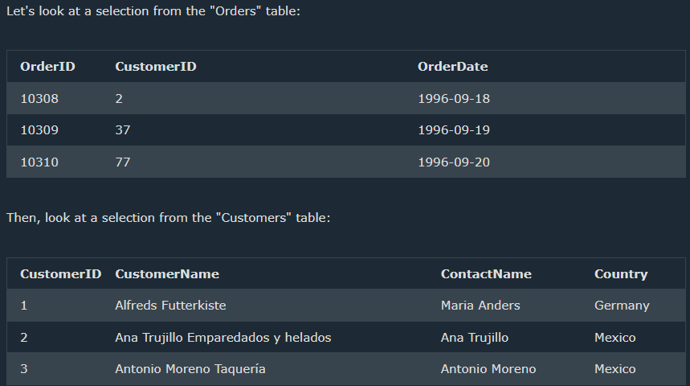
SQL JOINS
The SQL JOIN statements are used to join multiple table together, using a related column between them. Example: To view the order ID, Order date, and Customer Name of each customers that placed orders, we can use the SQL JOIN statement:
SELECT orders.OrderID, customers.CustomerName, orders.OrderDate FROM orders INNER JOIN customers
Orders.CustomerID = customers.CustomerID;

Slide 43
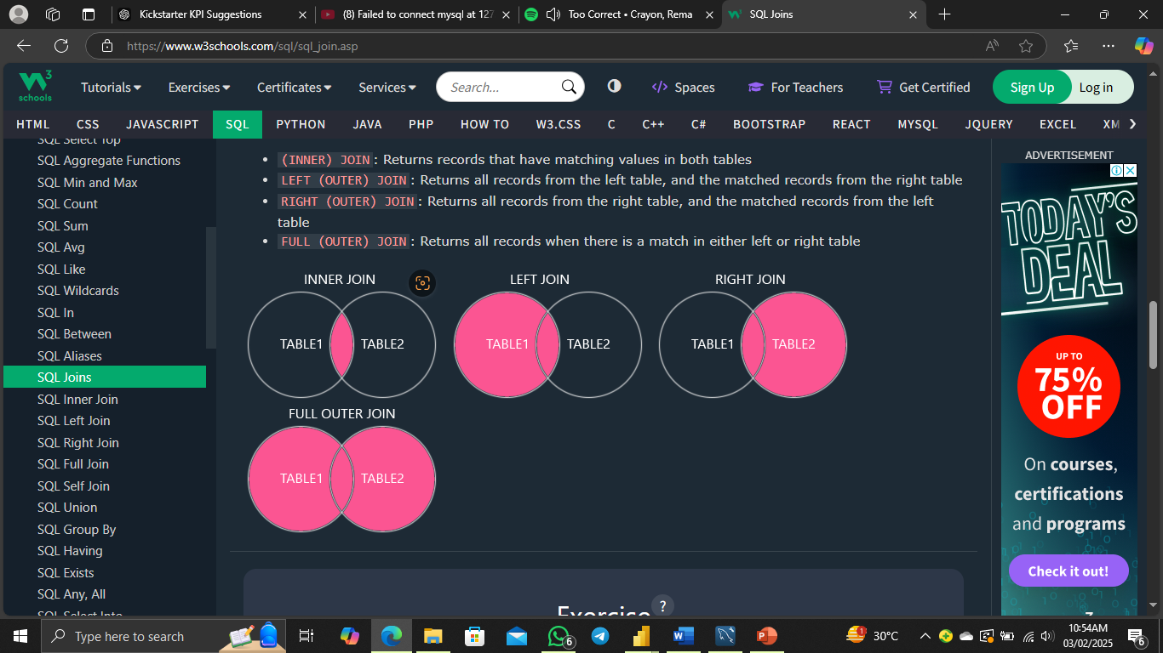
SQL JOIN Types

Slide 44
SQL DEFAULT Constraint
The DEFAULT constraint is used set a default value for a column. The value will only be added if no other value is entered into the column. Syntax:
CREATE TABLE Students (
ID int NOT NULL,
LastName varchar(255) NOT NULL,
FirstName varchar(255),
Age int,
City varchar(255) DEFAULT ‘Lagos’
);

Slide 45
NoSQL Databases
NoSQL (Not Only SQL) databases are designed to handle large volumes of unstructured and semi-structured data. Unlike traditional relational databases that rely on fixed schemas and tables, NoSQL offers flexible data models and supports horizontal scaling. This makes them well-suited for modern applications that require high performance, scalability, and the ability to manage diverse data types efficiently.
A flexible database used for big data and real-time web apps; social networks, search engines, etc.
Reference

Slide 46
Advantages of NoSQL over RDBMS
Handles big data.
Extremely flexible data model; no predefined schema.
It handles unstructured data.
Cheaper to manage.
It scales horizontally.

Slide 47
Recommended Materials
W3Schools SQL Tutorial : The Tutorial is an interactive resource for deepening your understanding of SQL syntax and commands. It provides comprehensive tutorials and a code editor, making it an ideal platform to enhance your SQL skills.
SQLZoo : This site offers interactive lessons and quizzes to help you practice SQL syntax and commands in a real-world context. It's an excellent place to refine your skills and gain hands-on experience with SQL.
LeetCode SQL: LeetCode SQL is a valuable resource for mastering SQL syntax and commands. With a wide range of challenging problems, it's perfect for enhancing your problem-solving abilities and your knowledge of SQL commands

